Slide 1

EduFusion AI: An Intelligent Agentic and Microservices-Based Framework for Smart Campus Optimization
SOA Project Review-1
Thursday, August 20th, 2026
 | Under the Guidance of Dr. Srikanth Cherukuvada Assistant Professor, Department of Computer Science and Engineering, KLH CSE Bowrampet Campus
Team Members B V S Jayadeep - 2420030381 S. Anjana - 2420030499 Ch. Bhargavi - 2420030588

Slide 2
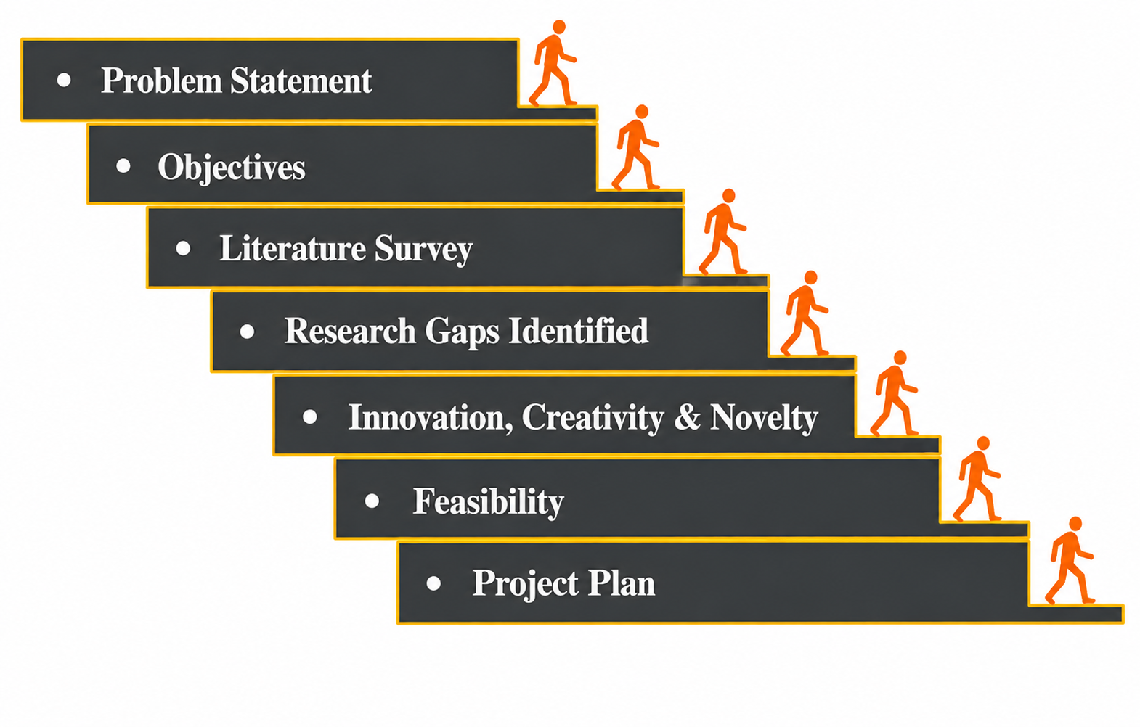
Outline of Research Work

Slide 3
Problem Statement
Modern educational institutions manage large amounts of data related to students, academics, classrooms, transportation, events, infrastructure, and administration. However, these functions are often handled through isolated systems, resulting in fragmented information, delayed decision-making, limited automation, and inefficient resource utilization.
EduFusion AI proposes an intelligent agentic and microservices-based framework that integrates campus services with autonomous AI agents to analyze real-time information, coordinate tasks, and support intelligent campus-level decision-making.

Slide 4
Objectives
Intelligent Agentic Campus Management
To develop an agentic AI layer with specialized agents for student assistance, academic support, resource allocation, event coordination, infrastructure monitoring, notifications, and administrative decision support.
Scalable Microservices Architecture
To design and implement independent, scalable campus microservices that communicate through well-defined APIs and event-driven mechanisms, providing modularity, fault isolation, maintainability, and scalability.
Intelligent Campus Optimization
To integrate campus data processing, prediction, and intelligent decision-making mechanisms to identify requirements, prioritize tasks, recommend suitable actions, and automate repetitive campus workflows

Slide 5
Literature Survey
Authors | Title of the Paper | Methodology | Inferences | Limitation/Future work
Dong et al. (2020) | Smart Campus: Definition, Framework, Technologies, and Services | • Reviews smart-campus technologies such as AI, IoT and cloud computing • Proposes a human-centred smart-campus framework • Identifies context-aware and data-driven smart services | • Smart campuses require integration of technology, infrastructure and services • Data-driven and context-aware systems can improve campus services | • Mainly provides a framework and review • Does not focus on microservice-based agent coordination or autonomous multi-agent campus optimization
Yamao et al. (2019) | Software Architecture Based on Microservices Applied in a Smart Campus Environment | • Implements microservice architecture in a smart-campus environment • Uses service-oriented architecture for campus sustainability | • Demonstrates that microservices can support independent smart-campus functions • Provides a foundation for scalable campus applications | • Focuses mainly on microservice architecture and IoT • Does not integrate autonomous Agentic AI for campus-level decision-making
Kostopoulos et al. (2025) | Agentic AI in Education: State of the Art and Future Directions | • Surveys autonomous, goal-oriented AI systems in education • Examines intelligent tutoring, adaptive testing and autonomous learning assistance | • Agentic AI can operate with limited human intervention • Agents can adapt to changing educational contexts | • Focuses primarily on educational/learning applications • Integrated agentic AI with campus infrastructure and microservices remains an open opportunity

Slide 6
Research Gap Identification
Existing Research | Identified Gap | Proposed Work
Smart-campus frameworks and technology integration | Limited autonomous coordination across different campus functions | Agentic AI-driven campus coordination
Microservices-based smart-campus systems | Microservices generally provide modular services but lack intelligent agent-based decision-making | AI agents interacting directly with campus microservices
Agentic AI in education | Existing work focuses mainly on learning, tutoring and student assistance | Agentic AI extended to campus-wide operational optimization

Slide 7
Innovation, Creativity, and Novelty
1. Autonomous Multi-Agent Campus Coordination
Specialized AI agents will independently analyze campus requirements, communicate with relevant microservices, and coordinate with other agents to accomplish complex campus-level tasks.
2. Agent-to-Microservice Intelligent Interaction
AI agents will not operate as isolated chatbots. They will interact with independent campus services through APIs and real-time/event-driven communication.
3. Predictive and Proactive Campus Optimization
The system will analyze campus information to identify operational requirements, prioritize tasks, recommend actions, and automate repetitive workflows rather than simply displaying existing information.
Self-Healing Microservices
A service-monitoring mechanism can detect failed services and support recovery so that failure of one campus service does not bring down the complete system.
5. Unified Intelligent Campus Platform
EduFusion AI combines:
Students + Faculty + Administration + Resources + Infrastructure
within one intelligent platform instead of treating each campus function as an isolated application.

Slide 8
Feasibility and Project Plan
Technical Feasibility
Can be implemented using:
Java, Spring Boot, Spring Cloud, React, PostgreSQL, Python, AI/ML libraries, REST APIs, Docker and Postman.
The proposed architecture uses independently deployable services, APIs, event-driven mechanisms, gateway-based access and centralized monitoring.
Economic Feasibility
The prototype can be developed using open-source software and simulated campus datasets, without requiring expensive physical campus infrastructure.
Operational Feasibility
The system can be demonstrated using simulated campus activities such as:
Student requests
Classroom allocation
Attendance monitoring
Resource utilization
Event coordination
Infrastructure alerts
Notifications
Research Feasibility
The system can be evaluated using:
Response time
Resource utilization
Prediction accuracy
Task completion rate
Service availability
Recommendation accuracy
Reduction in manual intervention
Project Plan
Phase 1: Research & System Design — Weeks 1–2
↓
Requirement analysis, literature survey, architecture design,
database design.
Phase 2: Microservices Development — Weeks 3–5
↓
Student, Faculty, Classroom, Attendance, Notification
and Resource services.
Phase 3: API Gateway & Service Communication — Week 6
↓
API Gateway, authentication, REST APIs, event-driven
communication and service monitoring.
Phase 4: Agentic AI Development — Weeks 7–8
↓
AI Coordinator + specialized agents for student assistance,
resource allocation, attendance, infrastructure and notifications.
Phase 5: Prediction & Optimization — Week 9
↓
Campus data processing, prediction models, intelligent
recommendations and optimization.
Phase 6: Frontend, Testing & Documentation — Weeks 10–12
↓
React dashboard, integration testing, performance evaluation,
Dockerization and final documentation.

